Slide 1
Image encryption
Proposal

Slide 2
User - password
To handle data provided by the user and generate all initial conditions is necessary create a big data.
A hashing algorithm is a mathematical function that condenses data to a fixed size.
There are hundreds of hashing algorithms, SHA algorithms. SHA stands for Secure Hashing Algorithm.
The most important factors for cryptographic hash algorithms is that they produce irreversible and unique hashes. Irreversible so that if you only had the hash you couldn’t use that to figure out what the original piece of data was, therefore allowing the original data to remain secure and unknown. Unique so that two different pieces of data can’t produce the same hash

Slide 3
SHA256 hash for any string or input value to generate a unique 64-digit hash for the value you specified.
Two logistic maps will be used to create 12 data from Sha256(User) or Sha256(Password) and after that combinate it to create all initial conditions used in the new system. Six initial conditions will be generated. For doing that two initial conditions will be generated from User and Data using the following combination. (http://www.iwar.org.uk/comsec/resources/cipher/sha256-384-512.pdf)
In this stage the following data are used:
USER: 0123456789
PASSWORD: 01234567890123456789

Slide 4






The user and password will be converted in sha256, then now the user’s data have 64 bytes, six initial conditions must be created to be used in the cryptosystem. From 64 bytes created twelve data will be randomly selected, in order to select these random numbers two logistic maps will be applied one of them to use in the User and the second one in the password. Twelve different random numbers are created after apply the logistic maps, these positions means the data that we have to copy from the 64 bits.
USER:
PASSWORD:
U(1) | U(2) | U(3) | U(4) | U(5) | U(…) | U(…) | U(….) | U(n-1) | U(n)
P(1) | P(2) | P(3) | P(4) | P(5) | P(…) | P(…) | P(…) | P(m-1) | P(m)
USER PROCESS
USER PROCESS
$$IC=x[1]=\frac{\left.\left(255−U\left[1\right]\right)∗P[last\right]}{\left.255∗P\left[1\right]∗U[last\right]}$$
$$IC_1=x_1[1]=\frac{\left.\left(255−U\left[last\right]\right)∗P[1\right]}{\left.255∗P\left[last\right]∗U[1\right]}$$
$$x_{n+1}=(px_{n}\left(1−x_{n}\right)$$
$${x_1}_{n+1}=(p{x_1}_{n}\left(1−{x_1}_{n}\right)$$
$$\left.l_{n}=mod(floor\left(x_{n}×{10}^{15}\right), 64\right)$$
$$\left.{l_1}_{n}=mod(floor\left({X_1}_{n}×{10}^{15}\right), 64\right)$$
U_l=
5 | 62 | 38 | 42 | 5 | 61 | 20 | 8 | 10 | 15 | 18 | 19
Random numbers
P_l=
5 | 7 | 38 | 4 | 50 | 6 | 2 | 8 | 11 | 15 | 18 | 20
1
2
3 …
12
1
2
3 …
12

Slide 5
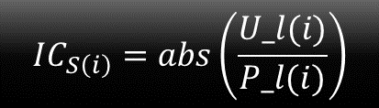
Once twelve random data has been created then data from sha256 must move until get a new vector
SHA256(USER):
6c9dc57ad9b3bef88ea57b454bb678246d5de6748b711c71fabaef7af5539147
SHA256(PASSWORD):
440b60c1ebdc236533c97031f7e4439b47be31d362c7a2d29ed332a300783454
U_S(1) |  |  |  |  |  |  |  |  | U_S(64)
P_S(1) |  |  |  |  |  |  |  |  | P_S(64)
SHA256(USER):
U_l=
SHA256(PASSWORD):
P_l=
U_S(1) |  |  |  |  |  |  |  |  | U_S(64)
5 | 62 | 38 | 42 | 5 | 61 | 20 | 8 | 10 | 15 | 18 | 19
substraction
-
-
-
-
-
-
P_S(1) |  |  |  |  |  |  |  |  | P_S(64)
$$IC_{S\left(i\right)}=abs\left(\frac{U_l(i)}{P_l(i)}\right)$$
5 | 7 | 38 | 4 | 50 | 6 | 2 | 8 | 11 | 15 | 18 | 20
addition
+
+
+
+
+

Slide 6
Bit Shuffling using a selected moving window
1 | 2 | … | … |  |  |  |  |  | N
This new novel method has two stages until attain the goal, our cipher image.
The first stage helps us to destroy completely the image symmetry and also to equilibrate the number of gray values.
In the plain-image all odd rows are flipped left to right, while the rows are flipped the complement is obtained of each row
1 |  |  |  |  |  |  |  |  | N

Slide 7
1
M
In the same stage the same all odd columns are flipped up to down, while the columns are flipped the complement is obtained of each row
1
M

Slide 8
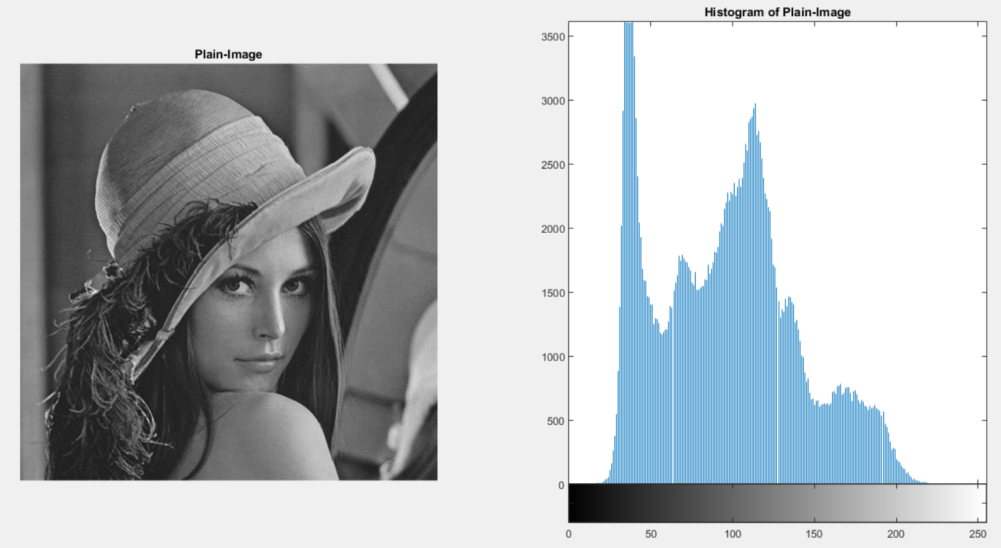
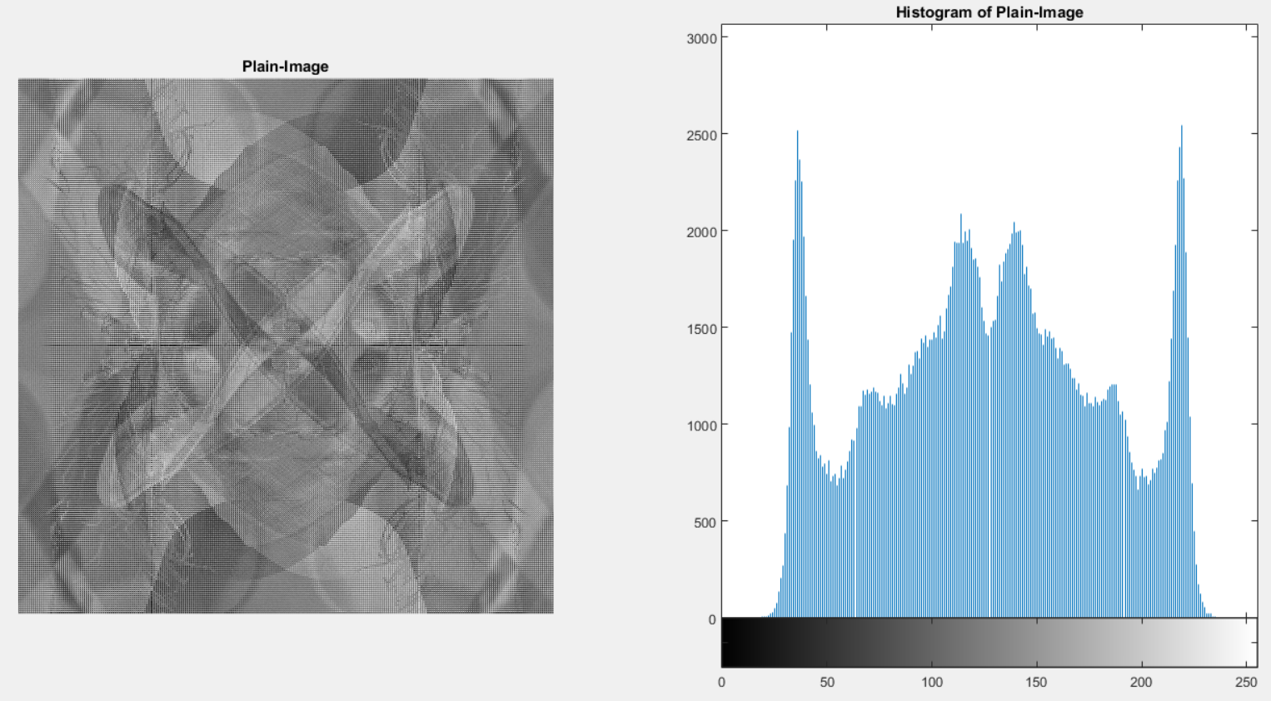
One of the most important part in this stage is that we have to calculate the complement of each odd flipped row and column, this means (255-Original_gray_value). The following image show the result step by step.
Plain - Image
255-Odd_Rows_Flipped left to right.
255-Odd_Columns_Flipped up to down.

Slide 9
Puzzle
To destroy the relation between pixels the stage called puzzle has been created, it depends on the image size this means length and width. The image will be destroyed in some equal parts, that is calculated, as a puzzle.
For example if the image size is 512 x 512, it will be divided in 64 windows in columns and 64 windows in rows, which windows size is 8x8
512(pixels)
512(pixels)
1 |  |  |  |  |  |  |  |  | 64
64
512(pixels)
512(pixels)

Slide 10
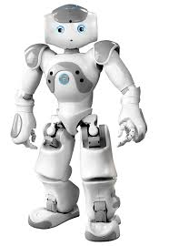
Puzzle example
Taking data of N and M and check if it is divisible by 2 , if it is the case that length or width is not divisible by two at the first time the subtract by 1 in the length or with is done. Consequently, the successive division is applied by 2, 3 or 5 until attaining less number as the following way:
8/2=4/2=2
This means 4 rounds in rows and columns with a windows size of 2x2
N=8 pixels
W_N=2 pixels
W_M=2 pixels
4 rounds
4 rounds
M=8 pixels

Slide 11
Puzzle example 2
-Working with height 8/2=4/2=2
This means 4 rounds in rows with window height of 2 pixels
-Working with width (9-1)/2=4/2=2
This means 4 rounds in rows with window width of 2 pixels, but we have one column as a remaining.
N=9 pixels
W_N=2 pixels
W_M=2 pixels
4 rounds
4 rounds
M=8 pixels
Remaining column

Slide 12



Shuffling using a selected moving window
To relocate all pixels or bits in this work the following method will be used:
Two different chaotic maps, the first one the original logistic map and the second one a variation of the logistic map called the logistic- sine wave will be used to generate new random positions. The equations will be showed:
Logistic Map$u_{n+1}=$ $ru_{n}$($1−u_{n}$)
Logistic sine wave
IC’s will be generated at the first stage for using in the logistic map and generating all new random numbers in order to be used in columns, Logistic sine wave just will be used to generate a new initial condition to be used in the next row.
$$\left.s_{n+1}=LSS\left(r,u_{n}\right)=(rs_{n}\left(1−s_{n}\right)+(4−r)sin{(}πs_{n})/4\right)$$
$$\left.u_{n}=S_{n}(1−S_{n}u_{n}\right)$$

Slide 13





$u_{n+1}=$ $ru_{n}$($1−u_{n}$)
$$\left.l_{n}=mod(floor\left(u_{n}×{10}^{15}\right),M\right)$$
U₁ | U₂ | U₃ | U₄ | U₅ | U₆ | U₇ |  |  |  |  |  |  |  |  |  |  |  |  |  |  |  |  |  |  |  |  |  |  |  |  | U₃₂
l₁ | l₂ | l₃ | l₄ | l₅ | l₆ | l₇ |  |  |  |  |  |  |  |  |  |  |  |  |  |  |  |  |  |  |  |  |  |  |  |  | l₃₂
$$\left.u_{n}=S_{n}(1−S_{n}u_{n}\right)$$
1 | 2 | 3 | 4 | 5 | 6 | 7 | 8 | 9 | 10 | 11 | 12 | 13 | 14 | 15 | 16 | 17 | 18 | 19 | 20 | 21 | 22 | 23 | 24 | 25 | 26 | 27 | 28 | 29 | 30 | 31 | 32
33 | 34 | 35 | 36 |  |  |  |  |  |  |  |  |  |  |  |  |  |  |  |  |  |  |  |  |  |  |  |  |  |  |  | 64
65 |  |  |  |  |  |  |  |  |  |  |  |  |  |  |  |  |  |  |  |  |  |  |  |  |  |  |  |  |  |  | 96
$$\left.u_{33}=S_{1}(1−S_{1}u_{32}\right)$$
$$\left.u_{65}=S_{2}(1−S_{2}u_{65}\right)$$

Slide 14
Reordering
Random Matrix
3 | 4 | 8 | 2 | 6 | 9 | 5 | 1 | 7
Selected moving window-bit
Original Position
1 | 2 | 3 | 4 | 5 | 6 | 7 | 8 | 9
20 | 10 | 15 | 51 | 45 | 78 | 54 | 12 | 18
Final Position
15 | 51 | 12 | 10 | 78 | 18 | 45 | 20 | 54

Slide 15
In the shuffling stage a selected moving window must be selected, the logistic-sine system is used in this stage to create all new random values and a logistic map is used to vary the initial conditions in each row as was explained before:
N(pixels)
1 | 2 | 3 | 4
5 | 6 | 7 | 8
9 | 10 | 11 | 12
13 | 14 | 15 | 16
Nb(bits)
M (pixels)
Mb (bits)
Plain Image

Slide 16

Results
Lena Image
Size 512 x 512
Window Size 16x16
Time 1.50 min

Slide 18
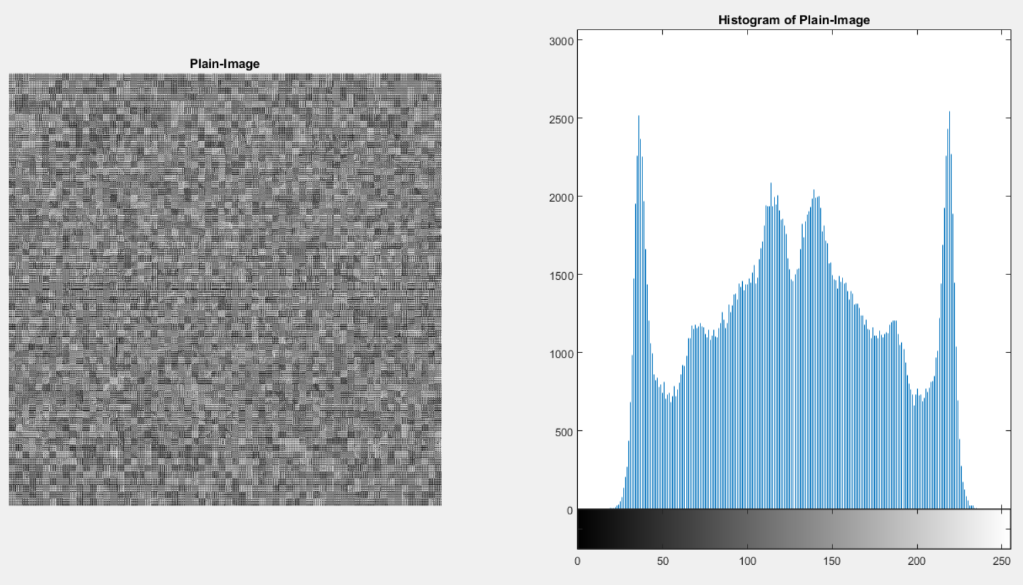

Slide 19
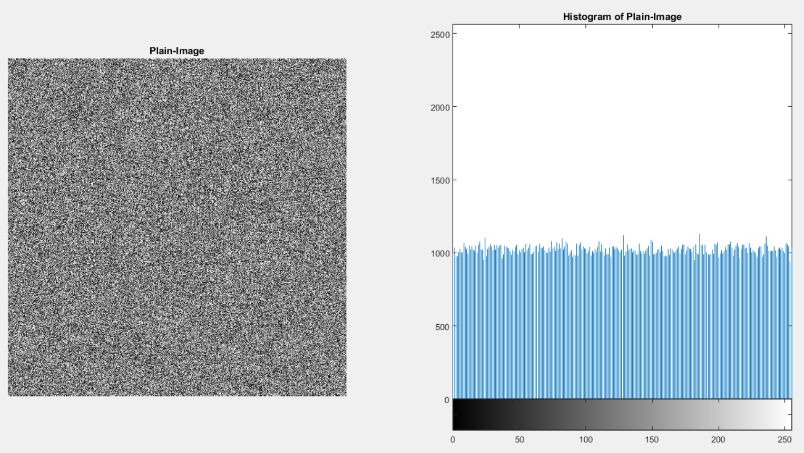

Slide 20
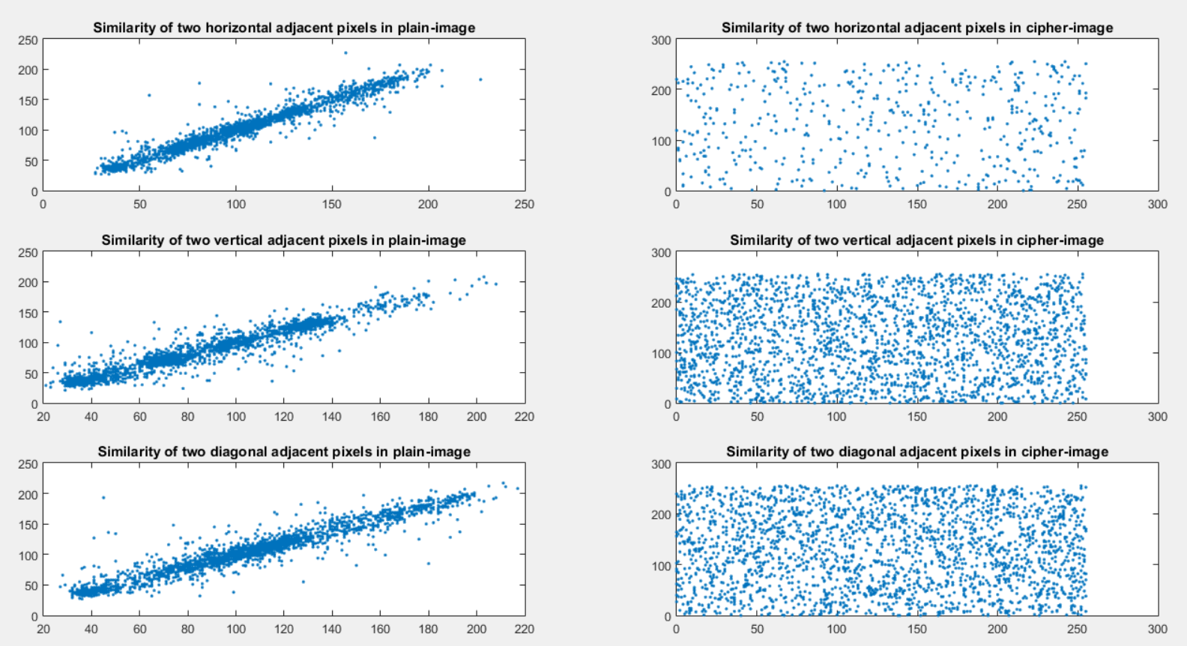
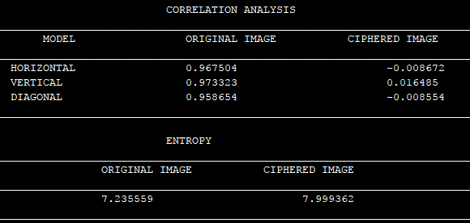
Correlation analysis

Slide 21
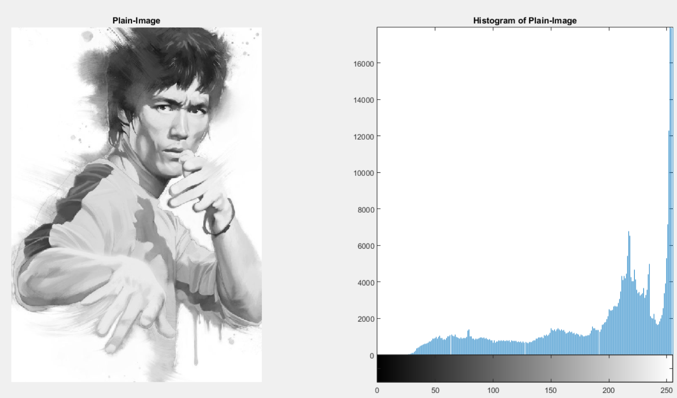
Lee Image
Size 600 x 849
Window Size 16x16
Time 2.99min

Slide 22
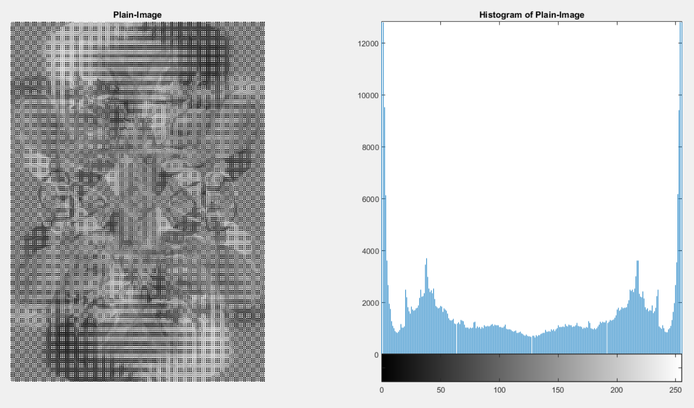

Slide 23
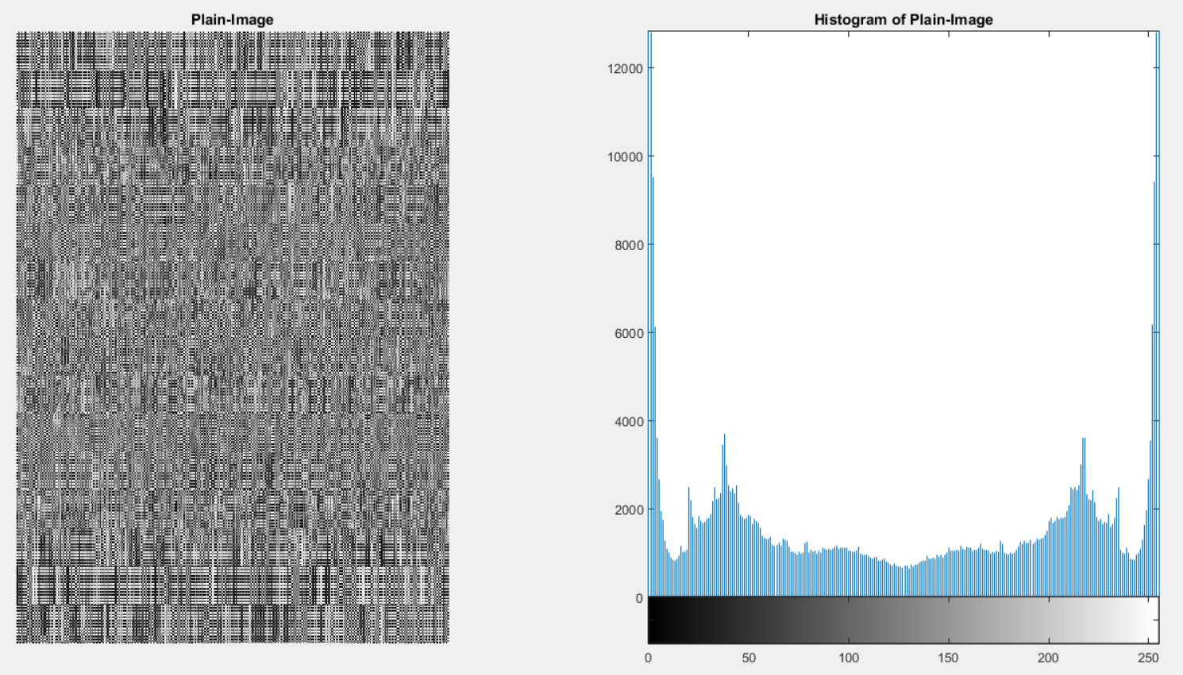

Slide 24
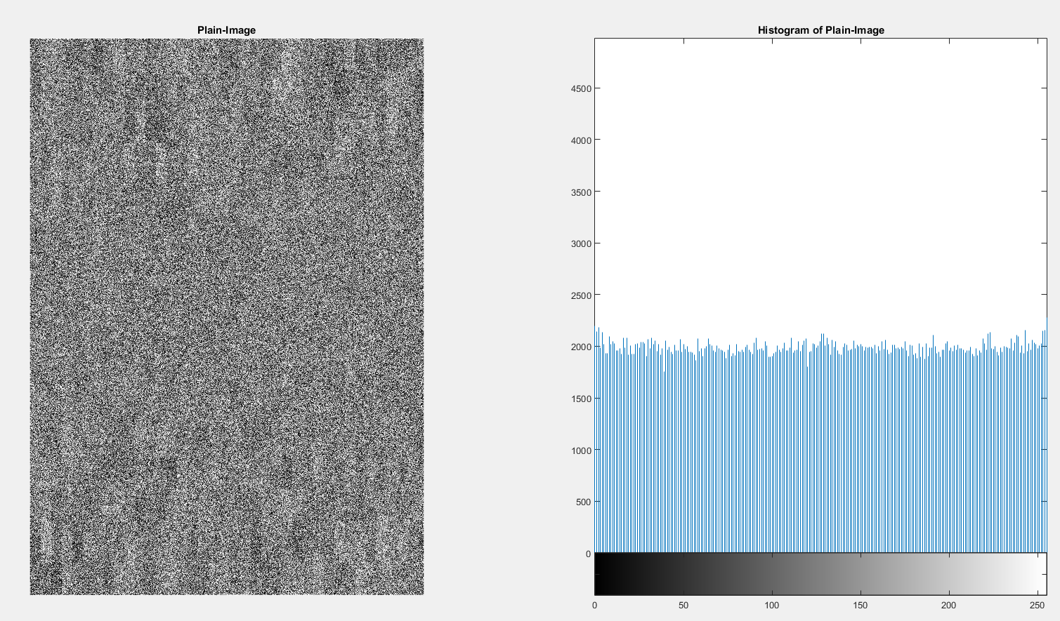

Slide 25
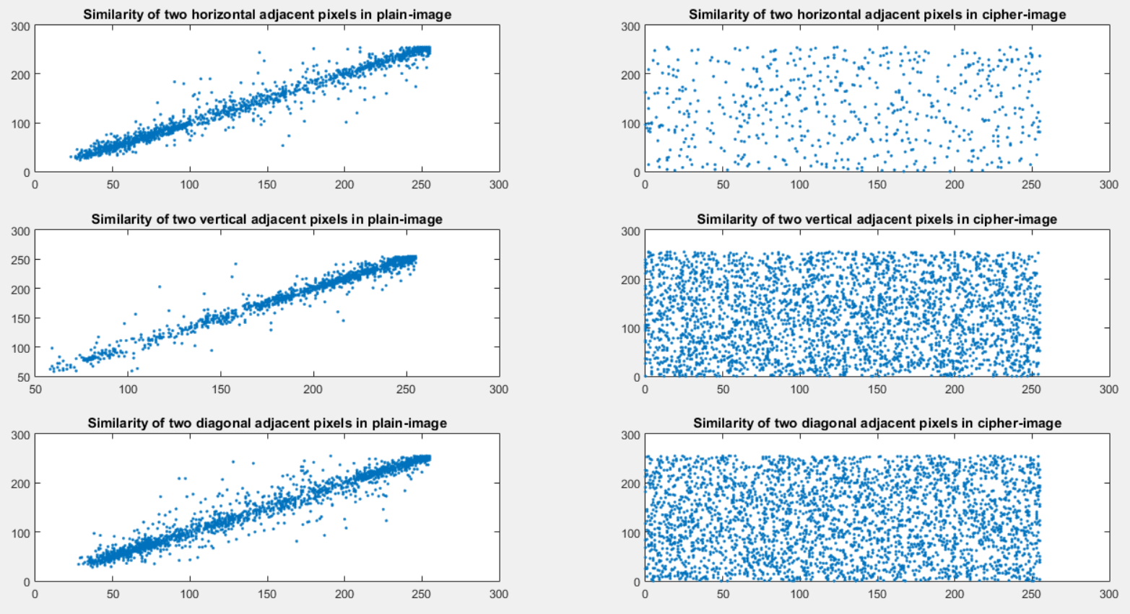
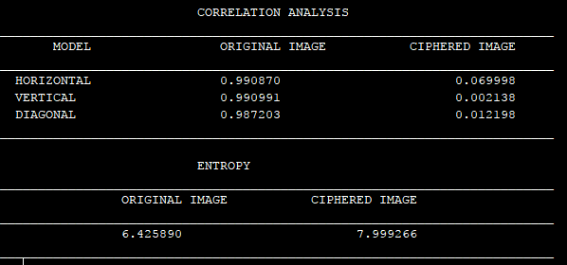
Correlation analysis

Slide 26
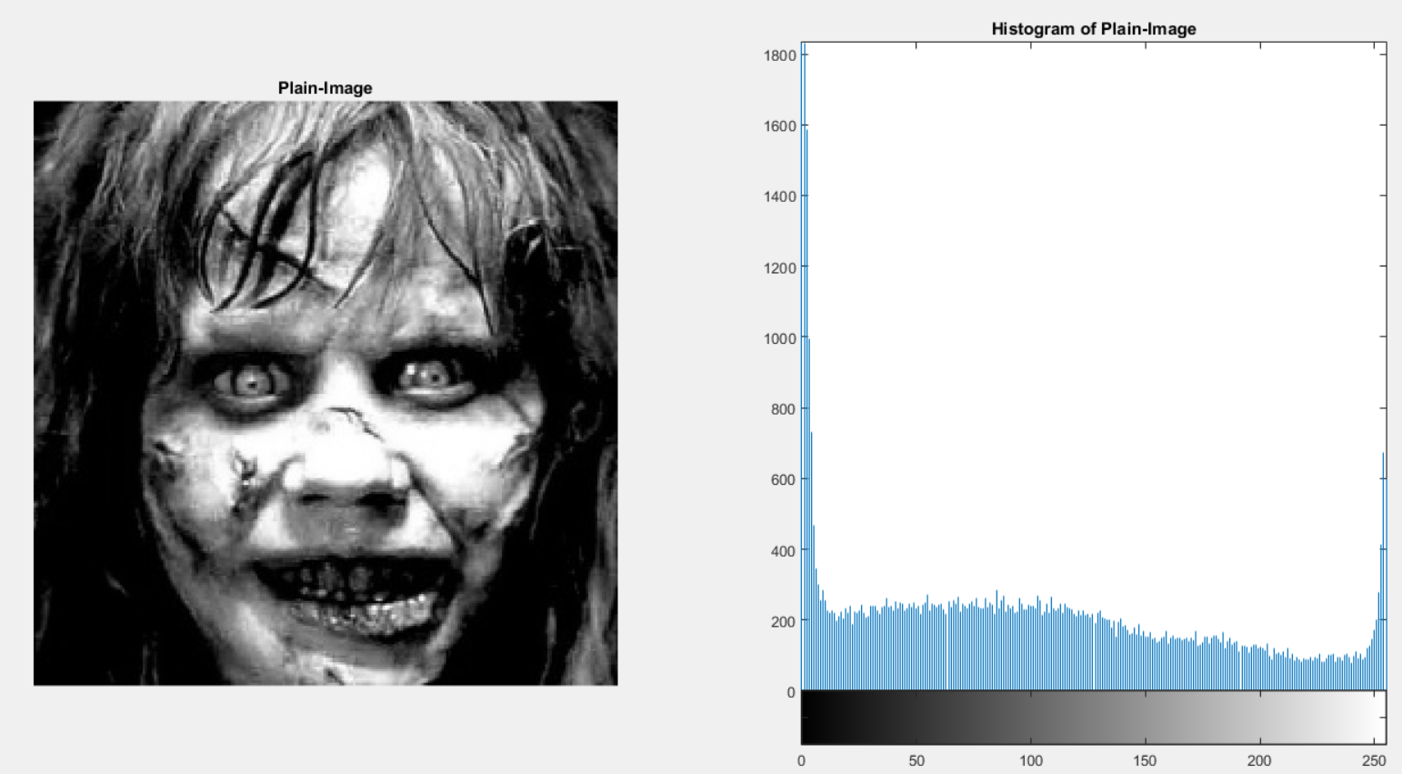
The Exorcist
Size 256x256
Window Size 16 x 16
Time 0.37 min

Slide 27
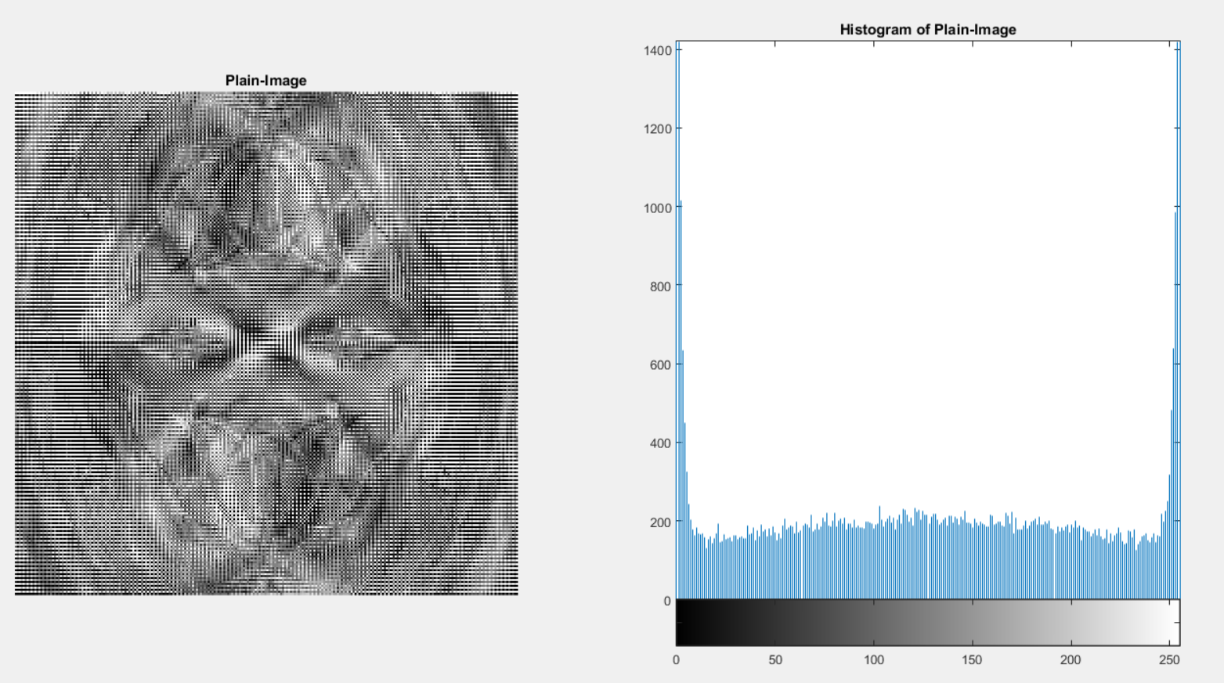

Slide 28
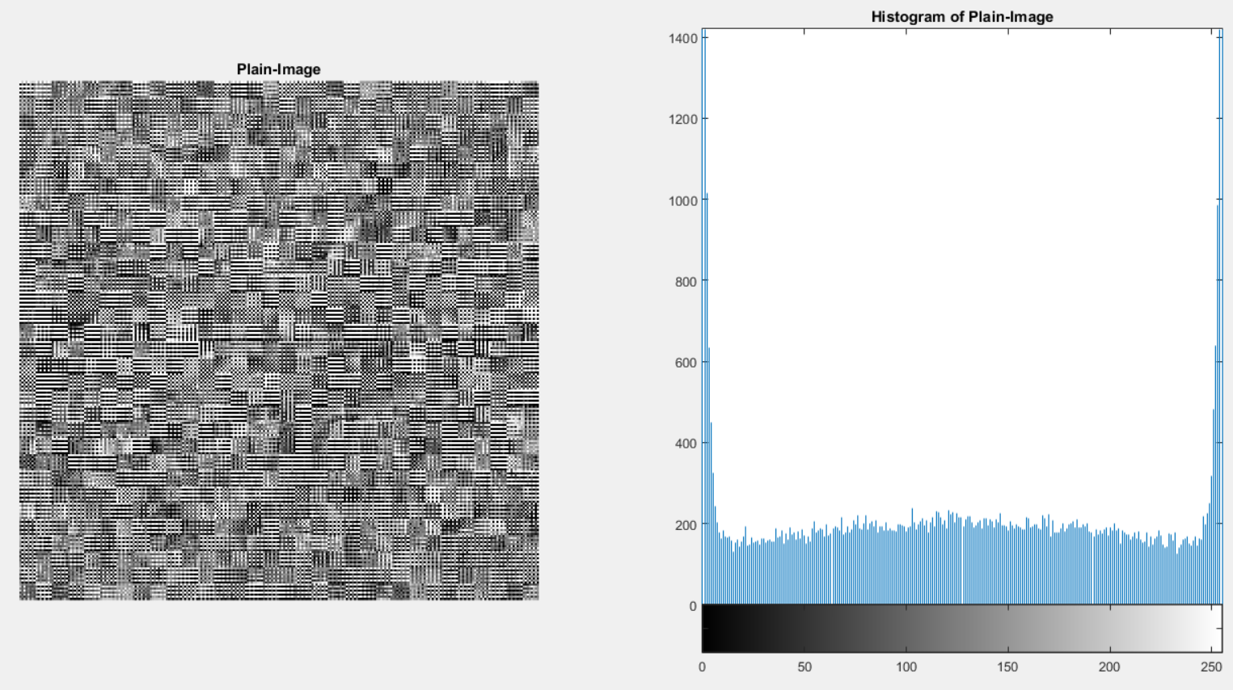

Slide 29
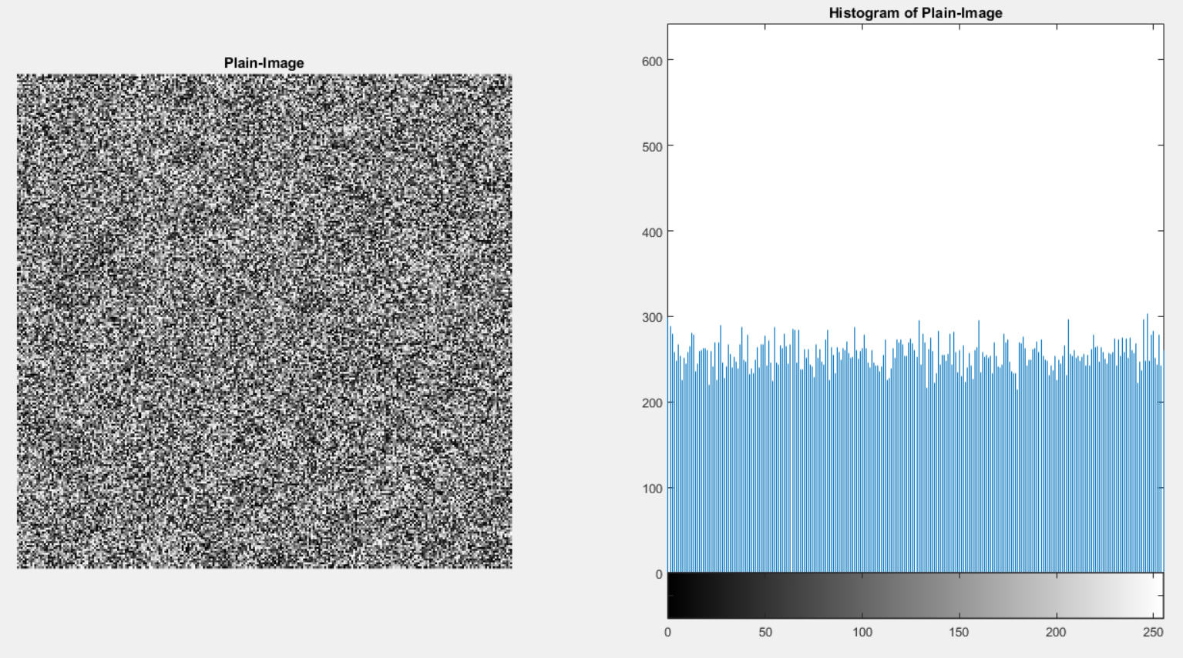

Slide 30
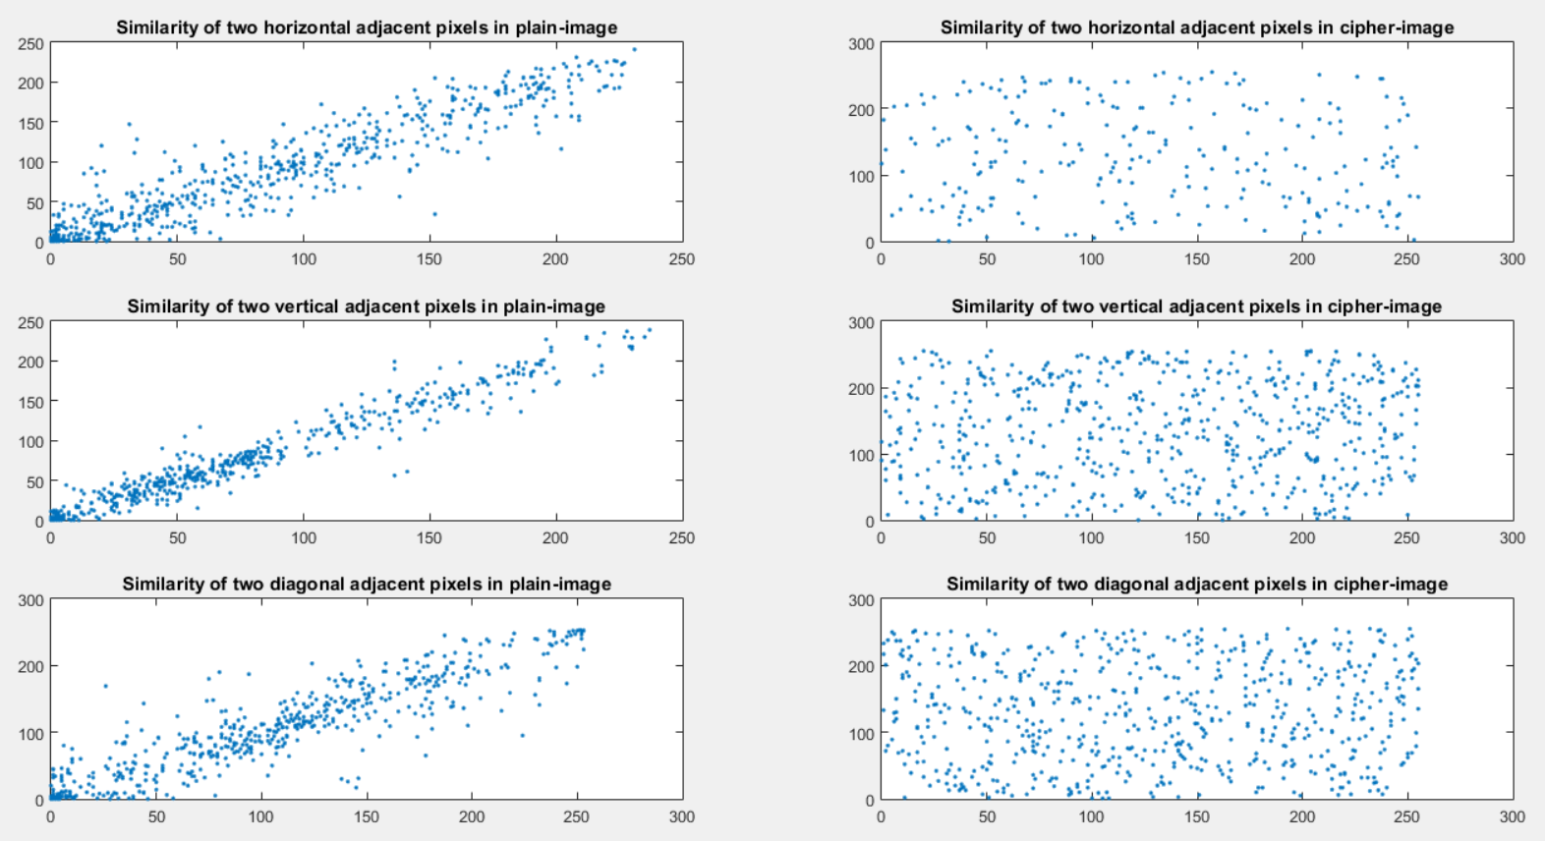
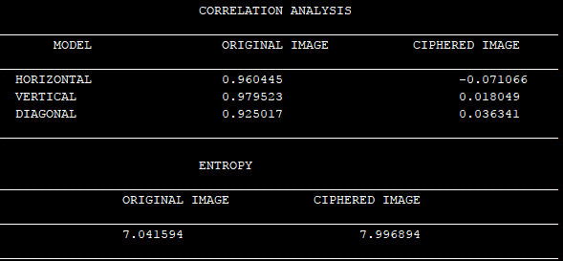

Slide 31
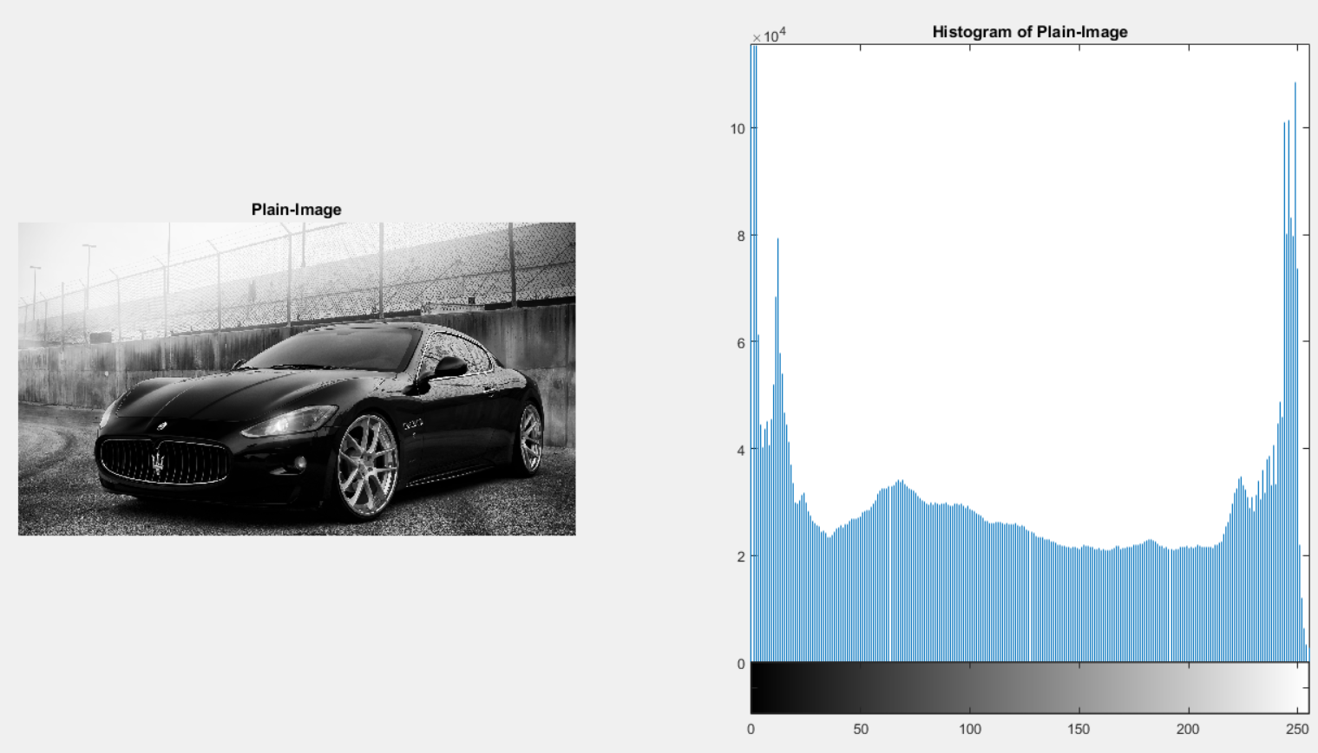

Slide 32
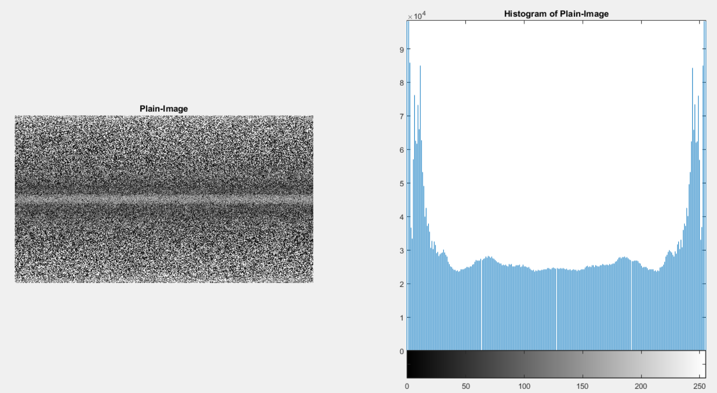

Slide 33
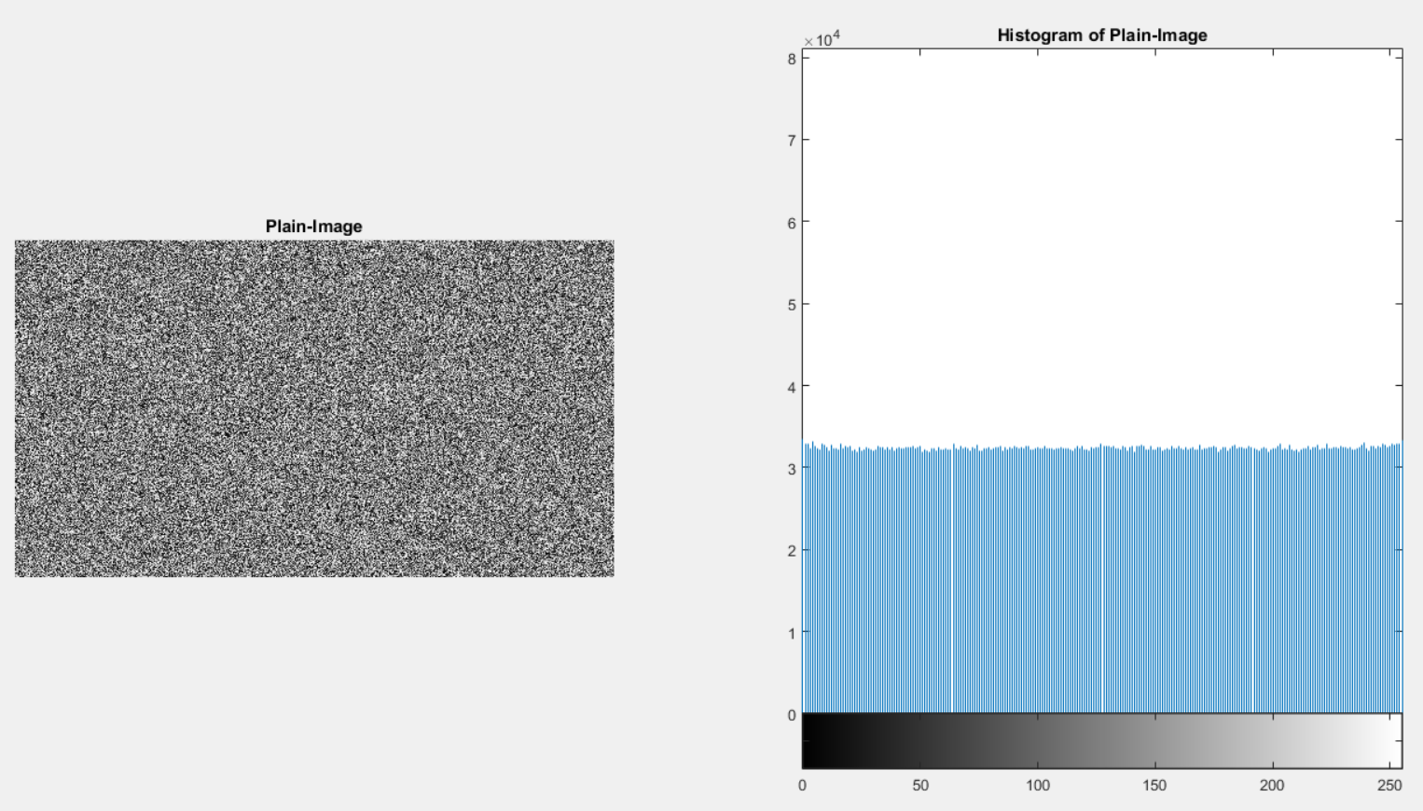

Slide 34
